Slide 1
게임 프로그래밍 (Game Programming)

Slide 2
내용
게임 디자인 기초
Unity Programming
Game algorithm (Game AI )

Slide 3
Game Design: Game Design Elements
Objectives
Mechanics
Game Play
Challenges
Resources (units)
Setting (temporal, spatial)
Character
Story
Premise
Interaction model
Player’s role
Perspective
Balance

Slide 4
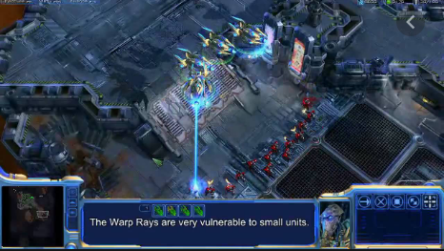
Why Game Engine ?
Unity vs Unreal
Unity vs
Cocos2d-X

Slide 5
Game AI Algorithm
How to make game units behavior like humans ?
AI for saving labor cost: creation of maps, characters, etc

Slide 6
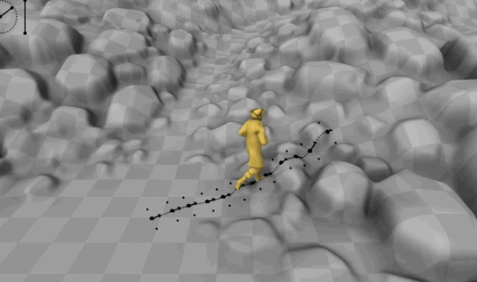

Slide 7
교재
- Game Design Part
Handouts
참고 교재: “Game Design Workshop by Tracy
Fullerton (pdf)
- Unity Part
Handouts
- Game Programming Part
“Artificial Intelligence for Game by Ian Milington”
(pdf)

